Slide 1
Figure 1. Module Framework
Strategic Plan & Scope
High Level Network Architecture
Strategic Considerations
Financial Constraints
Spectrum Regulation and Allocation
Equipment Supplier & MNO Agreements
Network Design
RAN Architecture
TX Network Architecture
Network
Monitoring Architecture
Mobile Core Architecture
Network Design
Deployment
Operations & Maintenance
Field Maintenance
Post-Launch Engineering
Supply Chain Management

Slide 2
Figure 2. Network Monitoring Functional View
Monitoring Strategy
Network Architecture
Selected Network Elements
Organization Technical Capabilities
Existing Equipment & Infrastructure
SLAs*
Parameters & Thresholds
Data Collection Strategy
Network Data Sources
Protocols & Technologies
Network Monitoring Reference Architecture
Functional Requirements
Event/Alarm Processing
Analytics
Dashboards & Reports
Solution Requirements for Vendor Selection
Security
Additional Features
Implementation Strategy
Topology & Infrastructure
Scalability
Procurement Strategy

Slide 3
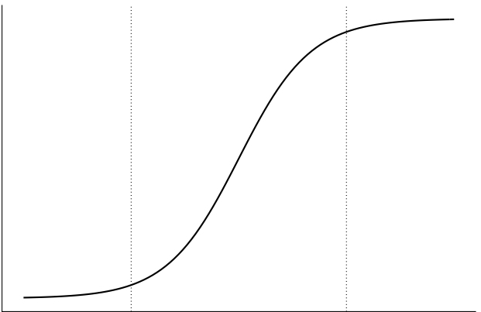
Figure 3. Operational Improvements and Data Collection Strategy.
Target Data Collection Strategy
Operational Improvement
Data Volume & Frequency

Slide 4
Figure 5. Network Analytics Categories
Prescriptive
Predictive
Diagnostic
Descriptive
Foresight
Which action should I take?
What is likely to happen?
Historical Data
Why is it happening?
What is happening?

Slide 5
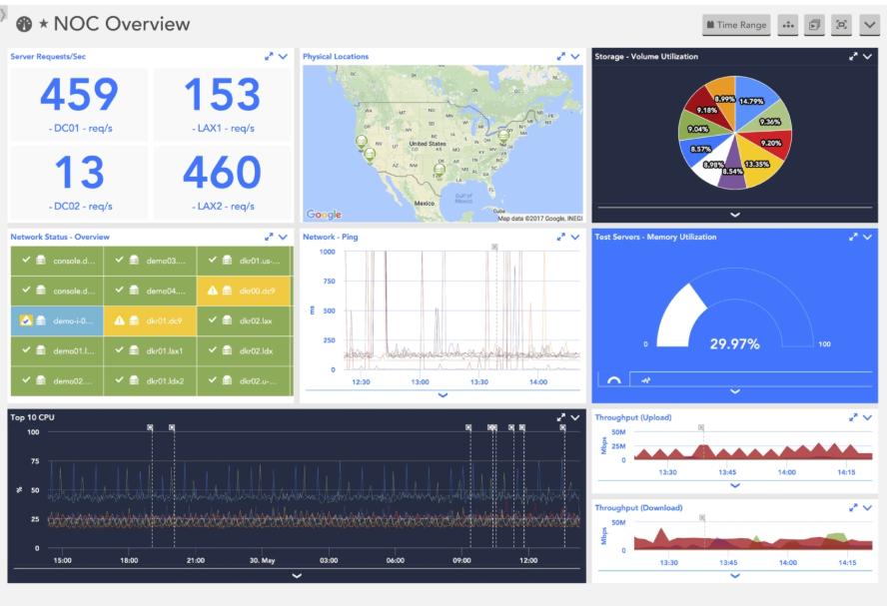
Figure 6. Network Monitoring Dashboard

Slide 6

Figure 7. Network Monitoring Functional Architecture
Network Monitoring
Real Time Processing
Dashboard & Reporting
(UI)
Collection Agents / Packet Brokers
Batch Processing
Long-Term Storage
Network

